Slide 1
BOOLEAN

Slide 2
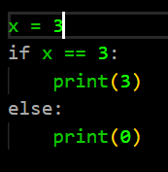
#1
X = 3 ?
yes
no
print(0)
print(3)
Code this tree in Python

Slide 3
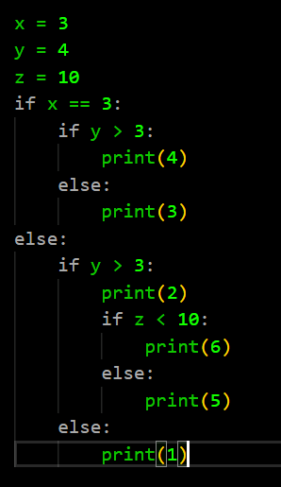
#2
X = 3 ?
yes
no
Y > 3 ?
Y > 3 ?
Code this tree in Python
no
yes
no
yes
print(1)
print(2)
print(3)
print(4)
Z < 10 ?
no
yes
print(5)
print(6)

Slide 4
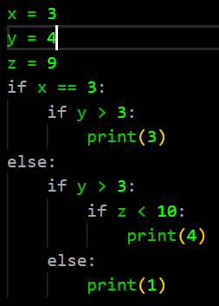
#3
X = 3 ?
yes
no
Y > 3 ?
Y > 3 ?
Code this tree in Python
no
yes
yes
print(1)
Z < 10 ?
print(3)
yes
print(4)

Slide 5
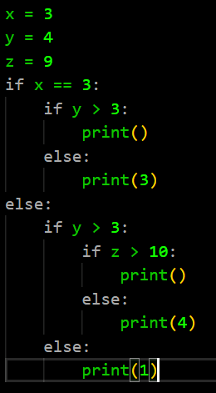
#4
X = 3 ?
yes
no
Y > 3 ?
Y > 3 ?
Code this tree in Python
no
yes
no
print(1)
Z < 10 ?
print(3)
no
print(4)

Slide 6
#5
Draw the tree of condition of this
code
No
X > 4
Yes
if x > 4:
if y == 5
print(«ronan»)
else
print(«channak»)
else:
if x == 3 or y == 4
print(«seiha»)
x = 3 or Y =4
Y = 5
No
Yes
Yes
print(“ronan”)
print(“ronan”)
print(“channak”)

Slide 7


#6
Write python !!!
Store in variable “value1” this :
x greater than 5 and y equal to 9
Store in variable “value2” this :
Y is equal to 1 or 2
Store in variable “value3” this :
Z is one of the following 5, 7, 9

Slide 8
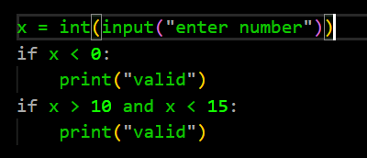

#7
Write python !!!
Write a program that say "valid" if a number entered by keyboard
if lower than 0 or between 10 and 15
You must use 2 variable :
one to store if number of lower than 0
one to store if between 10 and 15

Slide 9
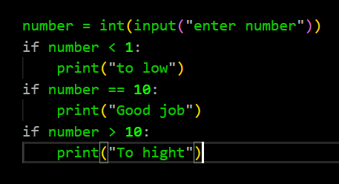
#8
Write python !!!
1 - Enter a number
2 - Display:
“to low” if the number displayed is lower than 1
“Good job” if the number is equal to 10
“To high” is the number is greater than 10
You must use 3 boolean variables

Slide 10
IF – ELIF – ELSE

Slide 11
Exercise 1
Q1
What will be the result if x is equal to 5 ?
if x > 4:
print("red")
if x < 7:
print("blue")
Answer: red
blue
Q2
What will be the result if X is equal to 5 ?
if x > 4:
print("red")
elif x < 7:
print("blue")
Answer: red

Slide 12
Exercise 2
Q1 What will be the result if x is equal to 8 ?
Q2 What will be the result if x is equal to 1 ?
if x > 7:
print("one")
elif x > 2:
print("two")
One
nothing

Slide 13
Exercise 3
Q1 What will be the result ?
x = 8
print ( x > 8 or (x > 5 and x < 7))
Answer: False

Slide 14
Exercise 4
Q1 What will be the result ?
x = 4
print ( (x < 3 or x > 1) and x < 9)
Answer: True

Slide 15
Exercise 5
Q1
What shall be the range of value to display ‘red’ ?
Example : To display ‘blue’, value must be in the range [11, +infinity[
if value > 10:
print("blue")
else:
print("red")
Answer: To display ‘red’, value must be smaller than 10(9, 8, 7, 6...

Slide 16
Exercise 6
Q1 What will be the result ?
a = 8 b = 12 if a == 12: print("beautiful") if b >= 12: print("cute")
Answer: cute

Slide 17
Exercise 7
if x<=6: print(“red")
elif x<10: print(“green")
elif x<=23: print(“blue")
else: print(“pink")
Example : To display ‘red’ X must be in the range ]-infinity, 6]
Q1
What must be the range of X to display ‘green’ ?
Answer: to display ‘green’, X must be smaller than 10 and between 7 to 10
Q2
What must be the range of X to display ‘blue’ ?
Answer: to display ‘green’, X must be in the range[ -infinity, 23]
Q3
What must be the range of X to display ‘pink’ ?
Answer: to display ‘pink’, must be the value before false all.

Slide 18
Exercise 8
Q1 What will be the result ?
isGreater = 4 > 9
if isGreater :
print("A")
else:
print("B")
Answer: B

Slide 19
Exercise 9
Q1 What will be the result ?
isGreater = 4 > 9
value = 50
print(isGreater or value > 20)
Answer: True

